Slide 1
LE26-105 What's new: Enhanced sales analytics
Kennie Nybo Pontoppidan

Slide 2
Business Value
Set focus on customer loyalty
Analyze recurring and churned customers
Easier built-in reporting
Use enhanced Excel reports and built-in analysis views
Notes:
LE25-100

Slide 3
Enhanced Sales Analytics (highlights)
New Power BI reports for customer loyalty
(Power BI and Excel reports for item ABC analysis)
Added subtotals to Excel layouts for the built-in sales reports
Added analysis tabs
Demo data for sales

Slide 4
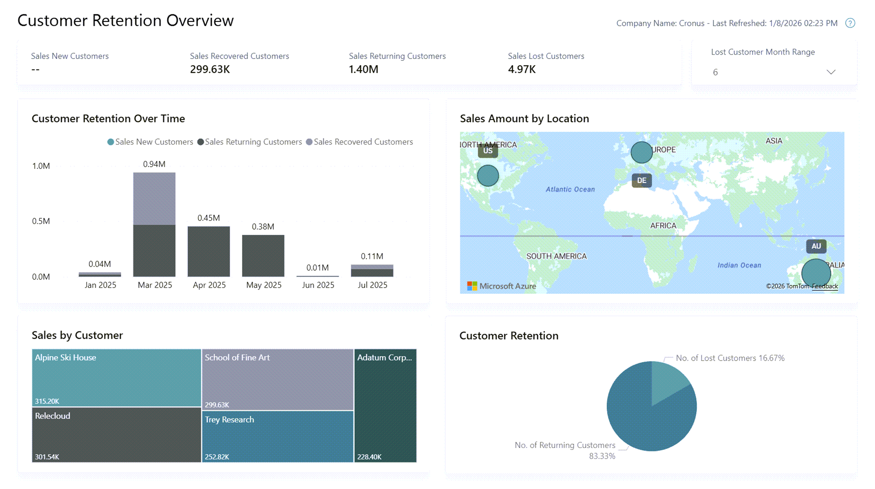
New Power BI reports for customer loyalty
Customer Retention Overview
Customer Retention History

Slide 5


Slide 6
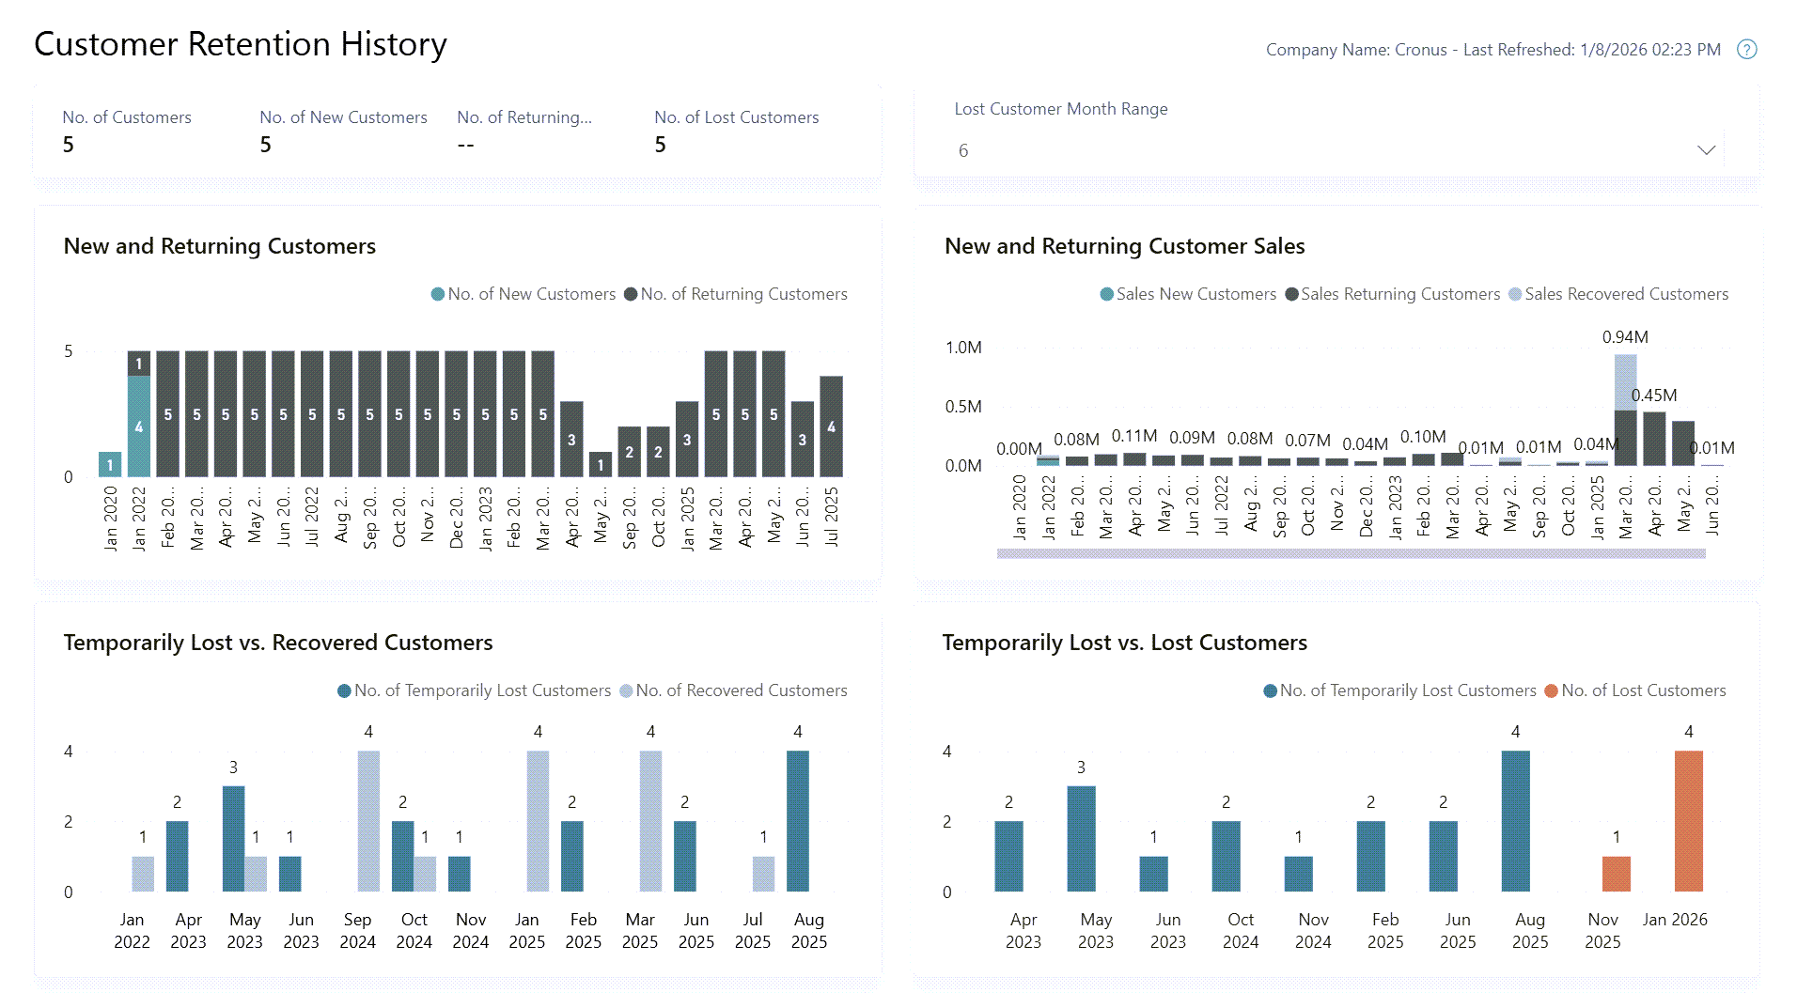

Slide 7
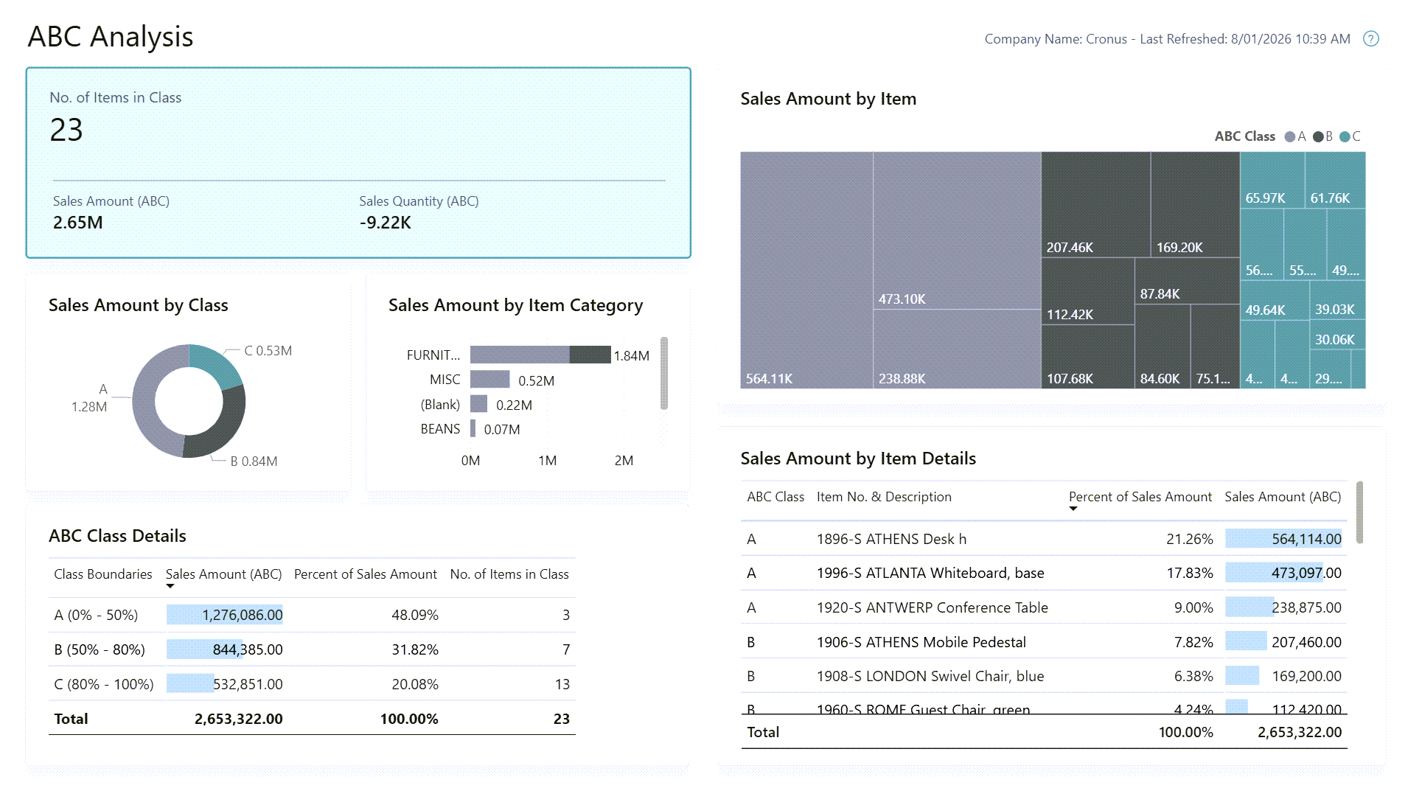

Slide 8
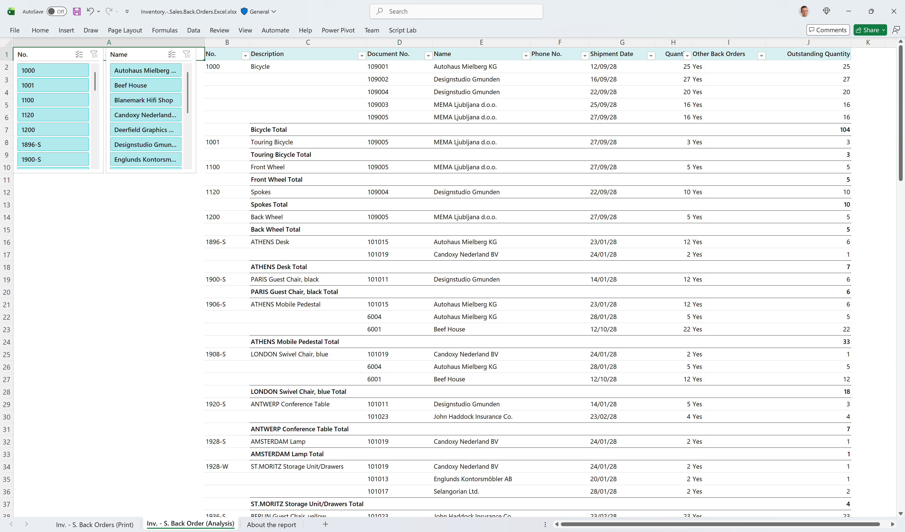
Added subtotals to Excel layouts for the built-in sales reports (28.x)
Salesperson Commission
Customer/Item Sales
Inventory Order Details
Inventory Customer Sales
Inventory - Sales Back Orders

Slide 9
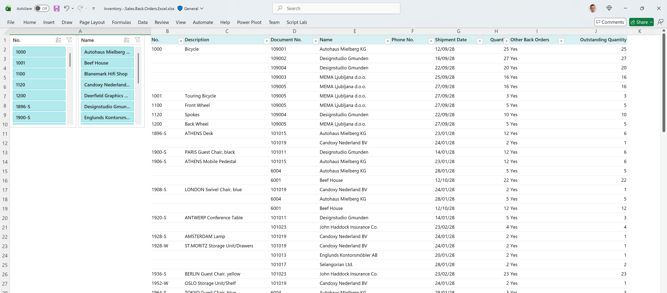
In 2025 release wave 2

Slide 10

Now in 2026 release wave 1

Slide 11
Analysis tabs added to sales pages (28.x)
Sales order list
  Expected sales volume
  Customer sales by volume
  Aged accounts by month

Slide 12
Enhanced Demo data (sales)
Sales
Open sales orders (9->20)
Sales back orders (8->17)

Slide 13
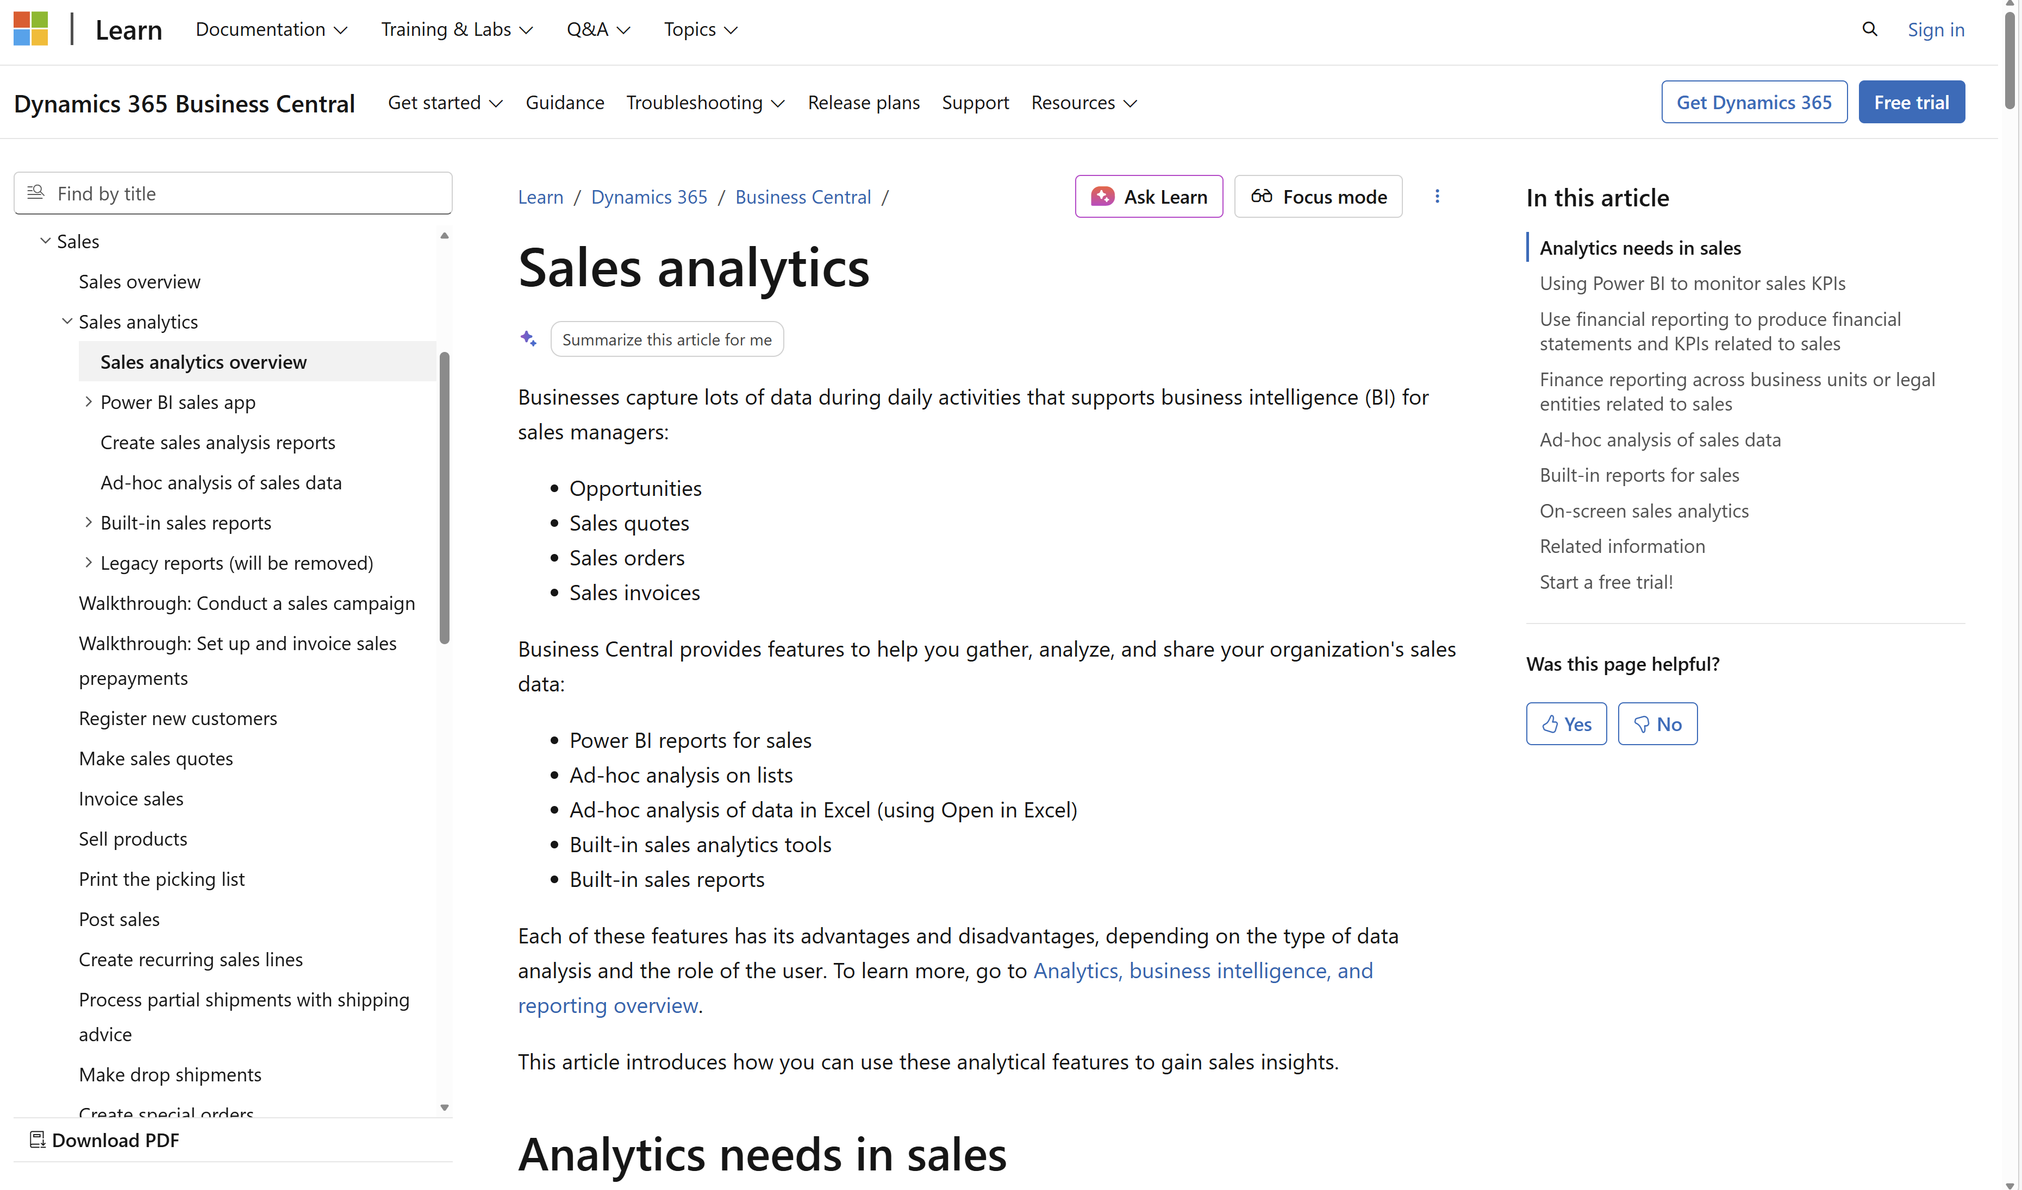
Want to learn more?
aka.ms/
bcSalesAnalytics

Slide 15
Related sessions
What's new: Enhanced inventory analytics
What's new: Enhanced finance analytics
What's new: Enhanced Financial Reporting
What's new: Enhanced subscription billing analytics
What's new: Enhanced Power BI and Excel with Business Central
What's new: Enhanced Analysis Mode

Slide 16
General Business Central resources
Learn more!
Looking for resources?
Watch more on YouTube
aka.ms/BCAll
aka.ms/BCYouTube
Join Viva Engage to ask questions
Follow on LinkedIn
aka.ms/BCLinkedIn
aka.ms/BCVivaEngage
Join the office hours
Microsoft page for partners
aka.ms/BCOfficeHours
aka.ms/BCPartnerPortal

Slide 17



LinkedIn
Follow the weekly news and announcements
on the Microsoft Dynamics 365 Business Central page
aka.ms/BCLinkedIn

Slide 18

Watch more videos on YouTube
One-stop shop to watch Business Central videos:
  What is new
  Copilot and AI
  Short tips and tricks
  Technical deep dives
  Under the Hood podcast series
aka.ms/BCYouTube

Slide 19
THANK YOU

